Slide 1
Optimizing Petrol Distribution and Management using Decentralized Multi-Agent-Oriented Programming.
Course Teacher:
Flavien Balbo
Olivier Boissier
Luis Gustavo Nardin
Presented By:
Tareq Md Rabiul Hossain Chy

Slide 2
Problem Statement:
Petrol distribution and management is a complex and challenging task, especially in countries where petrol is a scarce resource.
The traditional centralized approach to petrol distribution has limitations that can result in inefficiencies, such as petrol shortages, long waiting times, and uneven distribution.

Slide 3
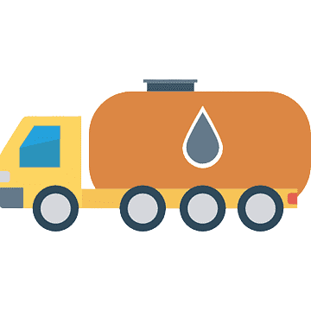
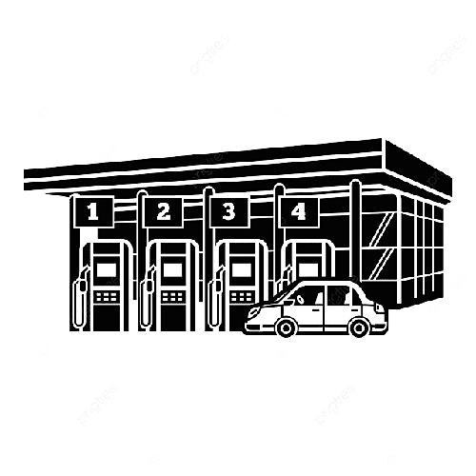

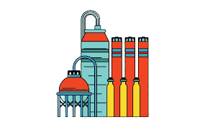
Global representation of agent and environment
Consumer Demand
Petrol Stations
Tanker Truck
Tank Refiner

Slide 4
Agent:
Petrol Station Agent
Tanker Truck Agent
Environment:
Petrol Station Agent.
Tanker Truck Agent.
Refiner.
Interaction:
Petrol Stations and Tanker Trucks
Tanker Trucks and Refiner
Petrol Stations
Tanker Truck
Tank Refiner

Slide 5
Consumer Demand
Petrol Stations
Tanker Truck status is "Full Tank and Not Assigned"
generate
current inventory levels &
demand forecasts
Tanker Truck status "Empty“
Tanker Truck
Tank Refiner

Slide 6
Organization:
1.The Petrol Station Agent must manage the petrol inventory at the station and ensure that petrol is available when needed.
2. The Petrol Station Agent must fulfil Consumer daily demand. It is responsible for maintaining a record of the petrol dispensed and the amount of petrol in stock.
3. The Tanker Truck is responsible for transporting petrol from the petrol refinery to the petrol stations. It receives requests for petrol deliveries from the Petrol Station Agent and delivery petrol when and where it is needed.
4. The Consumer demand is responsible for generating demand for petrol at each petrol station, based on historical data and other information. The Petrol Station Agent generate the forecasted demand based on historical data and other information.

Slide 7
Communication
Consumer Demand
Petrol Stations
Tanker Truck status is "Full Tank and Not Assigned"
generate
current inventory levels &
demand forecasts
Tanker Truck status "Empty“
Tanker Truck
Tank Refiner

Slide 8
Conceptual model to the simulation model
Consumer Demand
Petrol Stations
Tanker Truck
Tank Refiner

Slide 9
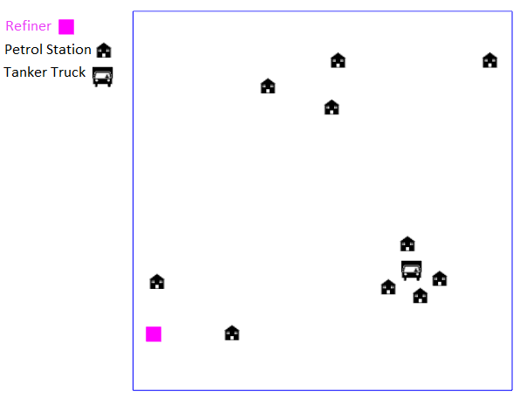
Scenario
For Centralized Approach (one Tanker Truck and Ten Petrol Station)

Slide 10
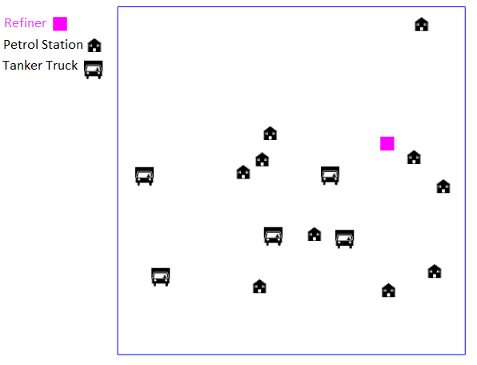
Scenario
For Decentralized Approach (Five Tanker Truck and Ten Petrol Station)

Slide 11
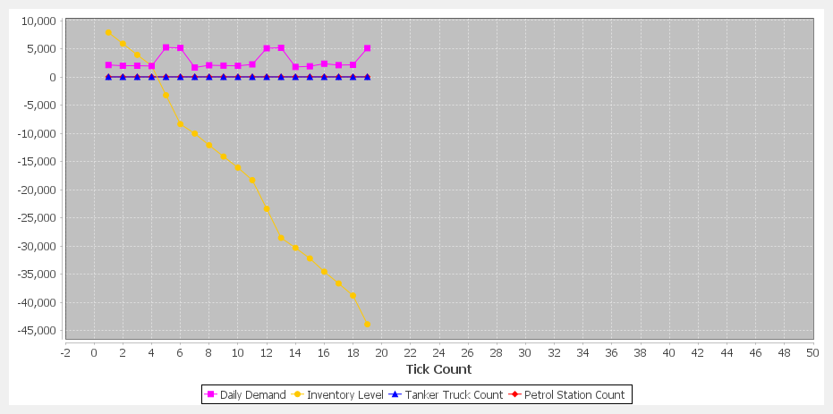
Results
For Centralized Approach (one Tanker Truck and Ten Petrol Station)

Slide 12
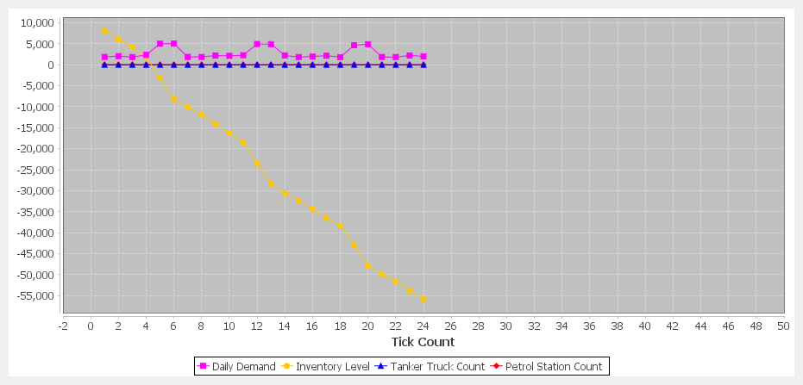
Results
For Decentralized Approach (Five Tanker Truck and Ten Petrol Station)

Slide 13
Discussion
After getting the result it can be mentioned that in the simulation model for decentralized approach provide best result for Optimizing Petrol Distribution and Management.

